Slide 1


ACCIDENT ALERT SYSTEM USING IoT
Project Guides Team Members
Mr. K.Ravikumar N.M.Abhinaya Harini
Associate Professor / CSE K.Bhuvaneshwari
Mrs. R.Saranya M.Indhu
Assistant Professor / CSE N.Nagapriya

Slide 2
Overview
Introduction
Abstract
Existing System
Proposed System
Modules
Screen Shots
Conclusion
Future Enhancement

Slide 3
Introduction
The Internet of Things (IoT) is the network of physical objects—devices, vehicles, buildings and other items—embedded with electronics, software, sensors, and network connectivity that enables these objects to collect and exchange data
It is also "things" embedded with electronics, software, sensors and connectivity to enable it to achieve greater value and service by exchanging data with the manufacturer, operator and/or other connected devices

Slide 4
Abstract
Driver fatigue is a significant factor in a large number of vehicle accidents
Driver drowsiness detection is one of the main objectives of our project
When a vehicle meets with an accident, alert to the ambulance service will be delayed
Hence an immediate alert must be sent to the nearest hospital is our prime motive

Slide 5
Existing System
A non-intrusive machine vision concept is used in Drowsiness Detection System
Web camera record driver’s head movements in order to detect drowsiness
It detect the signal will be sends to microcontroller
Microcontroller track the location of accident spot using GPS
Alert message including geographic allocation coordinates through the GSM Module to ambulance unit

Slide 6
Disadvantages of Existing System
Very expensive
Face Detection not accurate
Complex operation
Unable to determine when he/she will have an uncontrolled sleep onset

Slide 7
Proposed System
Detect drowsiness is by observing the eye blinking action of the driver
Driver will be getting drowsy, alarms the driver using buzzer or motor
When crash between the vehicles, depend upon vibration value alert or voice call will be send to nearest hospital

Slide 8
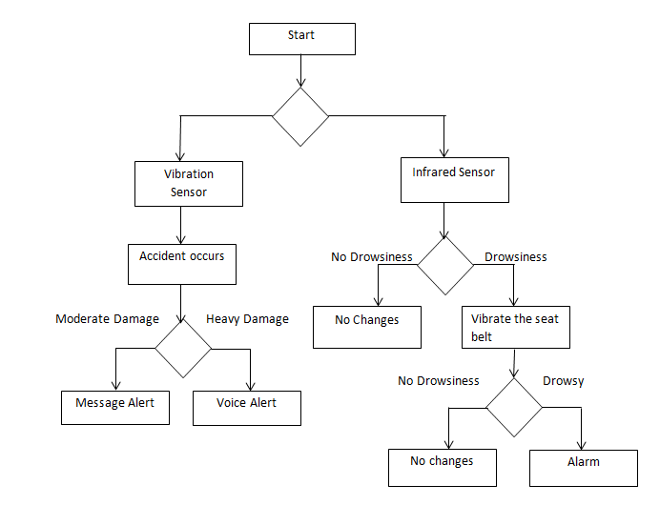
Proposed System

Slide 9
Advantages of Proposed System
Avoid accident due to drowsiness
Ease of use
Cost effective
High Life saving probability

Slide 10
Hardware Requirements
Processor - Intel Dual Core 15 E4160
Speed - 8MB Cache 3.0GHz
RAM - 8GB DDR3
Hard Disk - 500GB Serial ATA
Key Board - Standard Windows Keyboard
Mouse - Two or Three Button Mouse
Monitor - 18.5” Wide TFT Display
Sensors &component - IR sensor, Vibration sensor, GSM
Module

Slide 11
Software Requirements
Operating System - Windows XP/7
Programming Language - Embedded C/C++

Slide 12
Modules
Module 1:
Kit Connections will be made
Sensors connected are
(i) IR Sensor
(ii) Vibrate Sensor
Module 2:
(i) IR sensor detects drowsiness of the driver
(ii) Time is calculated. If the detected time is found to be greater than the given time then an alert is given to the driver by seat vibration

Slide 13
Modules
Module 3:
(i) If the vehicle is met with an accident, then the vibration sensor will be activated.
(ii) If the vibration resultant value exceeds the given value, an alert will be sent to the nearest hospital.

Slide 14
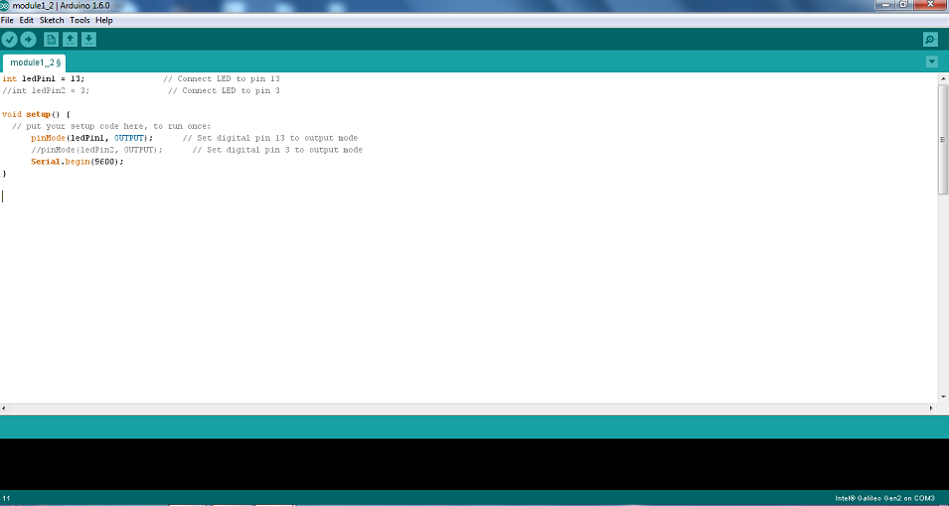
Screen Shots

Slide 15
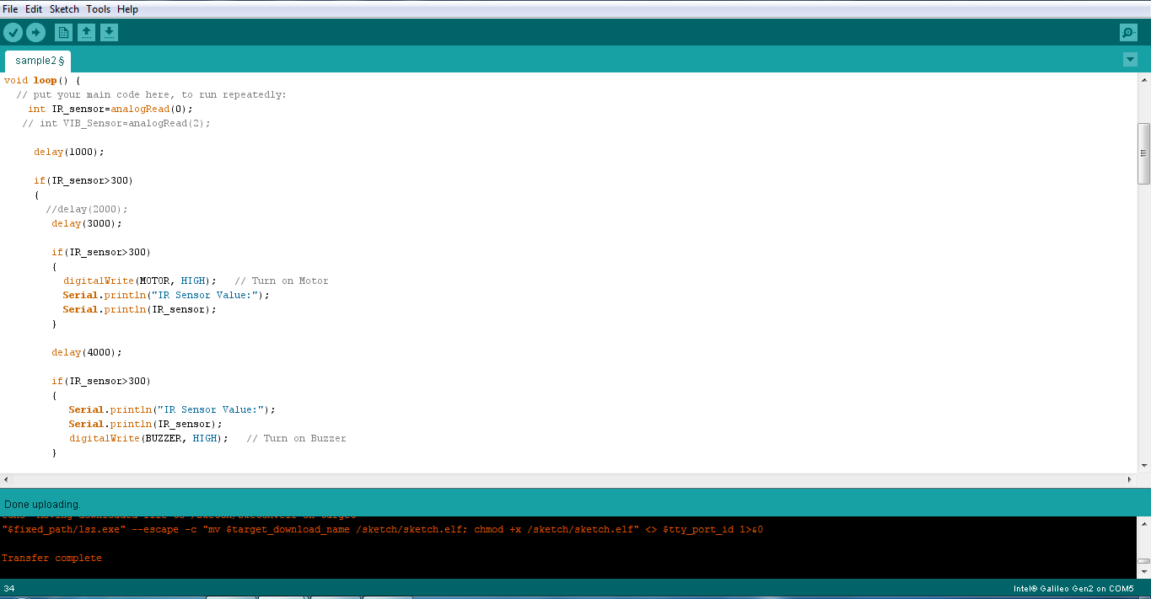
Screen Shots

Slide 16
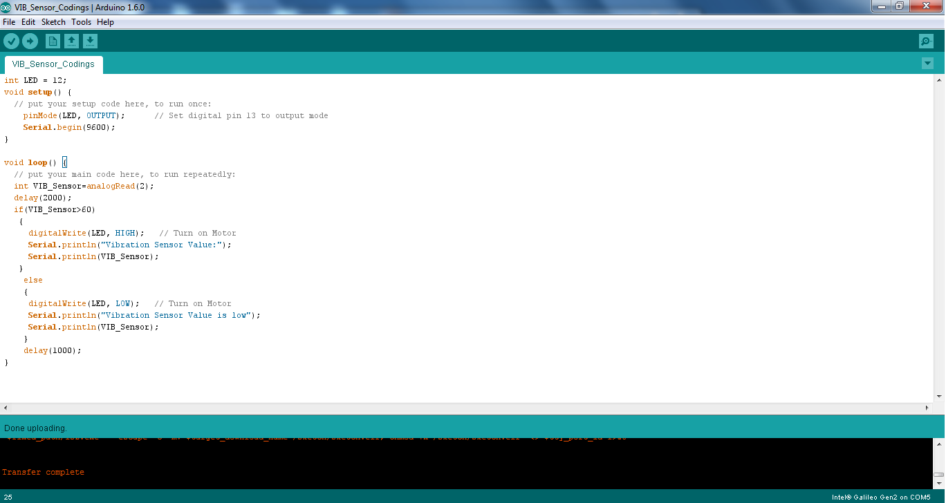
Screen Shots

Slide 17
Conclusion
Progressive technology offers some confidence to avoid these accidents up to some extent.
This project involves measure and controls eye blink using eye blink sensor.
Though we have many prevention techniques to avoid accidents internally, it can happens by many external factors.
Accident alert system automatically detects the accident and give a clear way in emergency on roads, so that they can reach their destination in least time without any delay to the hospital.

Slide 18
Future Enhancement
We can prevent accidents caused by drowsiness using the braking system
The accidents due to the drowsy state of the driver is prevented using automatic breaking system using Electronic brake-force distribution (EBD or EBFD)
To improve the rescue assistance in the accident zone, image processing can be used more effectively in order to determine the environmental factor with the exact location using GPS

Slide 19


